Slide 1
Spanish Wine Price Prediction Project

Slide 2
Business Problem Understanding
Business Problem We are trying to Solve
Constraints
Scope
Objectives

Slide 3
Business Problem We are trying to Solve
Information of different wineries and their wines are given and we want to fit a regression model to predict the price of each bottle.
We want to understand what factors are affecting price of wine.

Slide 4
Constraints
Some form of interpretability.
Minimize RMSE and Maximize R-2 Score.
Getting the Good model which will not over fit
Hyper-parameter Tuning of Good performing models.
Selection of Important Feature.

Slide 5
Scope
We can add more feature in the future to add them in our analysis.
In this way, We can retrain over model and there might be a possibility of getting good results.
Developing a well-integrated web application that can predict prices whenever users want it to will complete the project.

Slide 6
Objectives
Create an analytical framework to understand
Key factors impacting Wine prices
Develop a modeling framework
To estimate the price of a wine that is up
for sale
.

Slide 7

Data Preparation
Reading the Dataset- We have read the data and understand it and then we see the null values and some unwanted values in between the data which we removed in the next steps.
Data Cleaning
Variable transformation- Data type of year column is object , we need to convert it in numerical type. There are null values in the year ,type , body and acidity column.
Dealing With Missing Value- Filling the missing value in the type column with the mode
Filling the missing value in numerical variable using Median

Slide 8
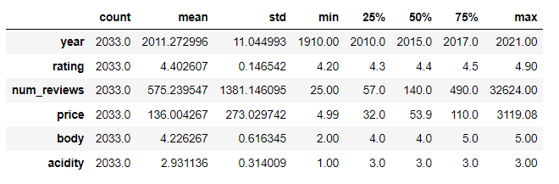
Analysis Of the Data

Slide 9
'year' value ranges from 1910 to 2021.As mean < median, we can say that it is **slightly left skewed.
'rating' ranges from 4.2 to 4.9.As mean and median are almost equal, we can say that it is **almost Normal Distributed.
'num_reviews' ranges from 25 to 32624.As mean is almost 4 times as of median , we can say that it is **Highly rightly skewed.
Also in this column we have very big difference between the 3rd quartile and maximum value , their is very high chances of having outliers.
'price' ranges from 4.99 to 3119.mean is more than twice as that of median , it is **Highly rightly skewed.
Also in this column we have very big difference between the 3rd quartile and maximum value , their is very high chances of having outliers.
'body' value ranges from 2 to 5 . Mean is slightly greater than median , it is **slightly right skewed.
Also in this column we can observe big difference between the 1st quartile and minimum value , their is very high chances of having outliers.
'acidity' ranges from 1 to 3 . Mean ~ Median , we can say that it is **almost Normal Distributed.

Slide 10

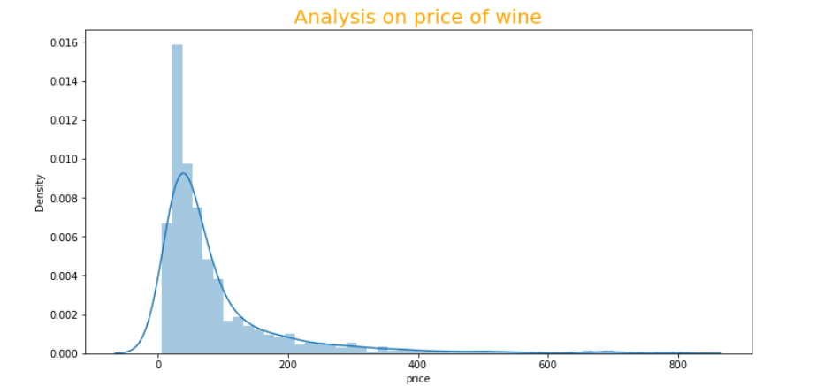
Analysis of Price (Target Variable)
Price of most of the wines less than 200.
The above graph shows that price has right skew ness . And we know that the assumption of linear regression tells us that the distribution of dependent variable has to be normal, so we should perform some operation to make it normal, in later part.

Slide 11
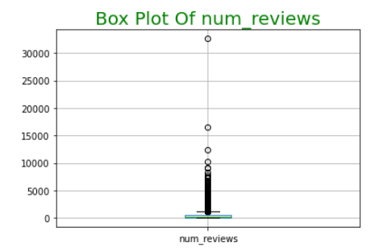
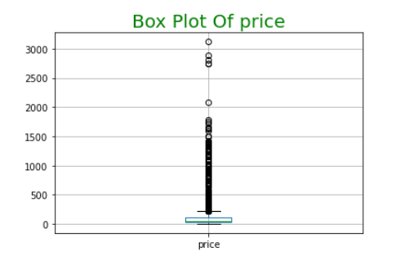
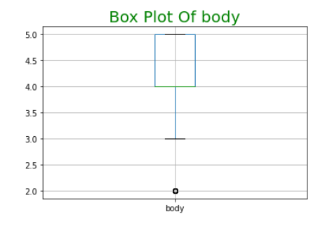
BOX-Plots
We can clearly see that there is outliers present in all these 3 columns.

Slide 12
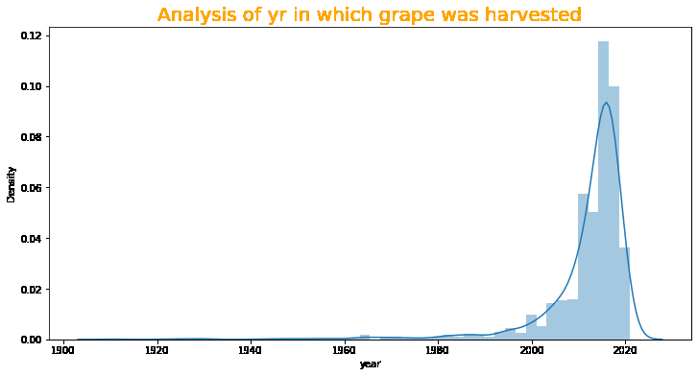
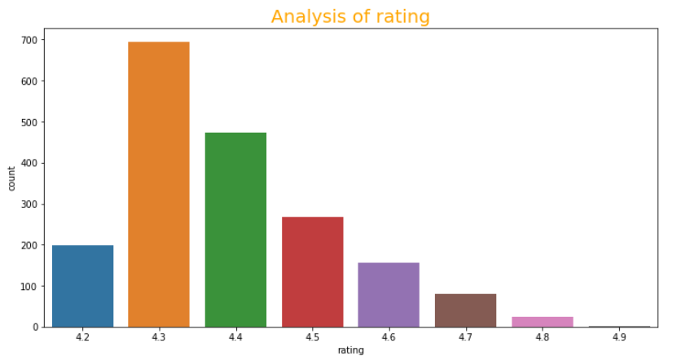
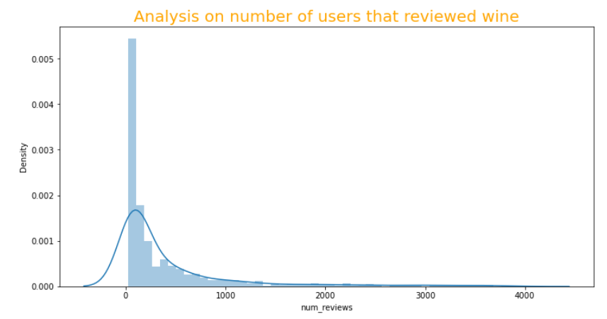
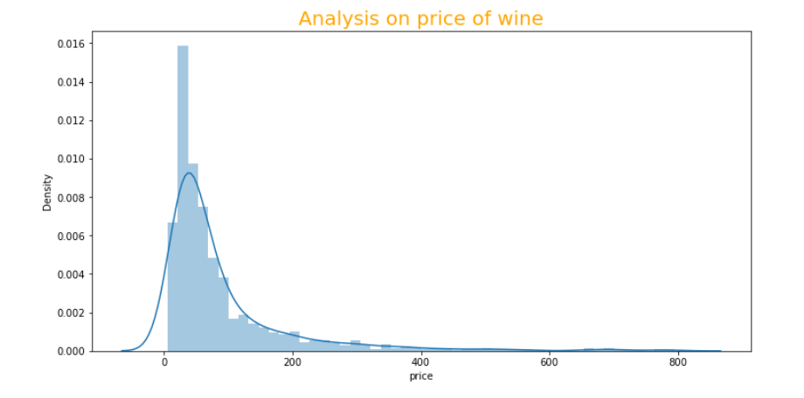
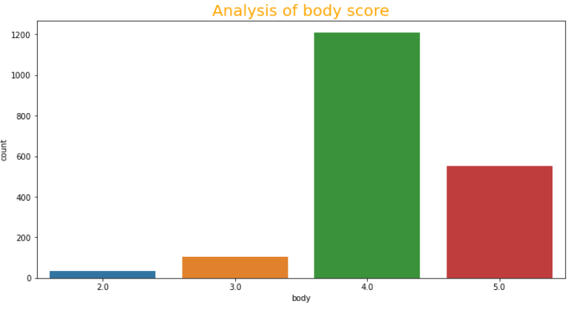
UNIVARIATE ANALYSIS

Slide 13
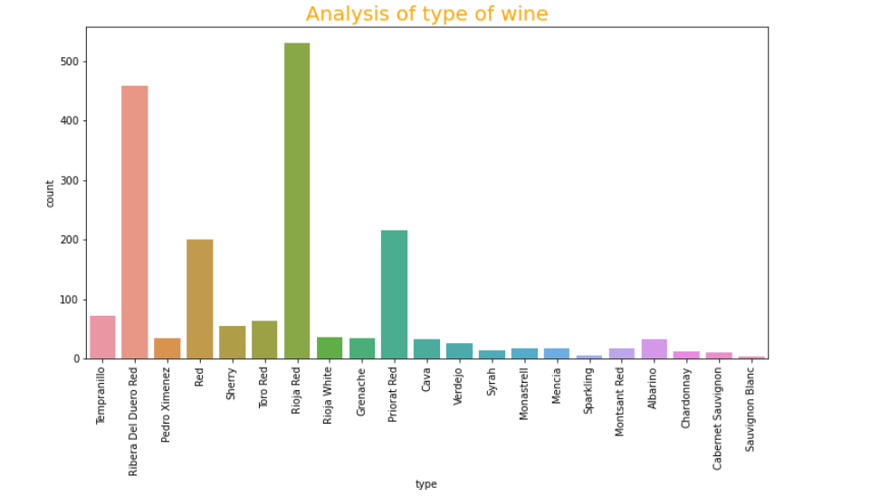
1. Wines are coming from 479 winery
2. There are 836 wine names.
3. Most of the wines are made of grapes which are harvested after 2000.
4. We can clearly see most of wine are rated between 4.3 and 4.5.
5. Most of the wines are reviewed by 100 users or less than 100 as we can clearly see a very big spike there.
6. Majority of wines are coming from the 3 regions : Ribera del Duero ,Rioja , Rioja.
Price of most of the wines less than 200.
7. 'Ribera Del Duero Red ', 'Red',‘ Rioja Red',‘ Priorat Red' are some of the most available wine varieties.
In which 'Rioja Red' has most sales followed by 'Ribera Del Duero Red'.
8. Majority of the wine are rated 4 or 5 , which says wine from Spain has good body score.
More than 90 % of the wine has high acidity rating.

Slide 14
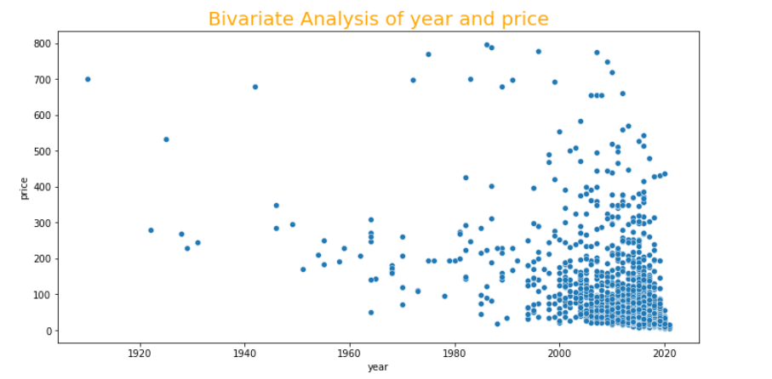
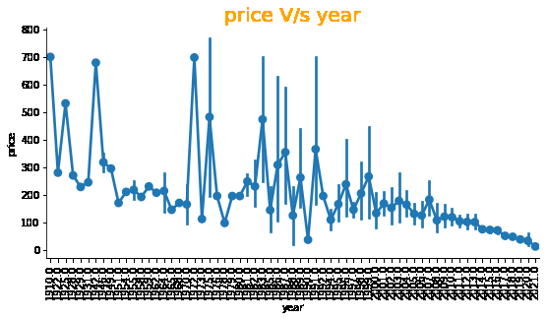
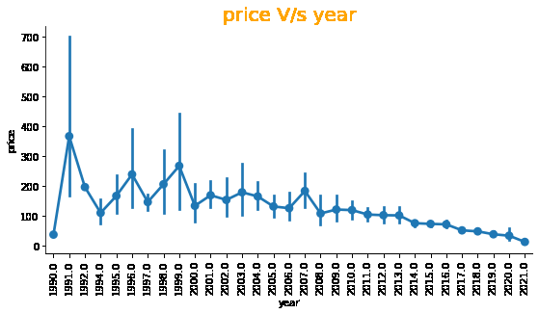
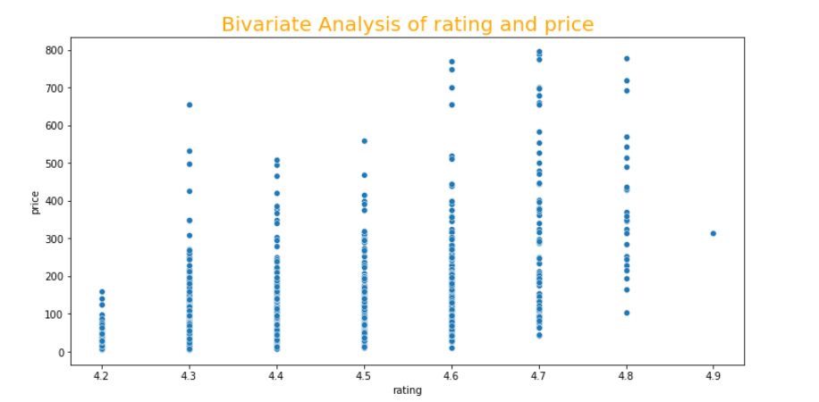
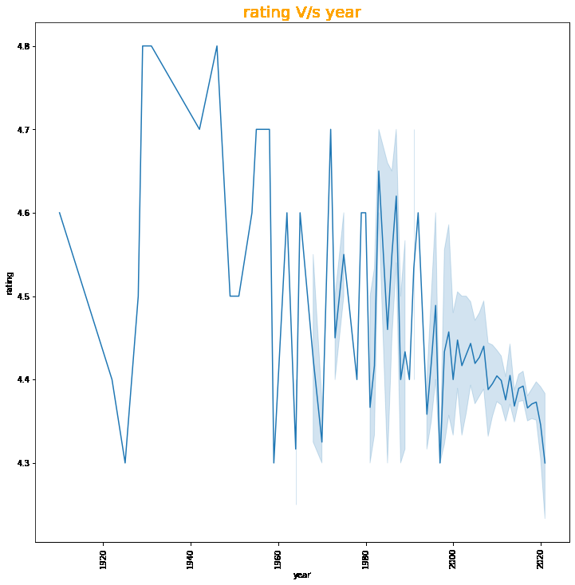
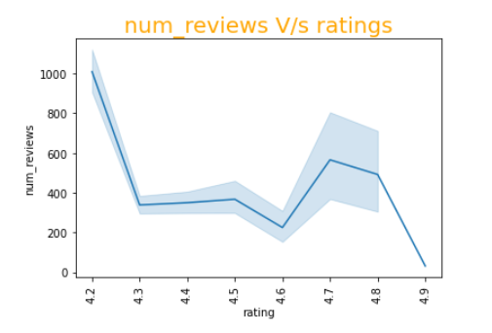
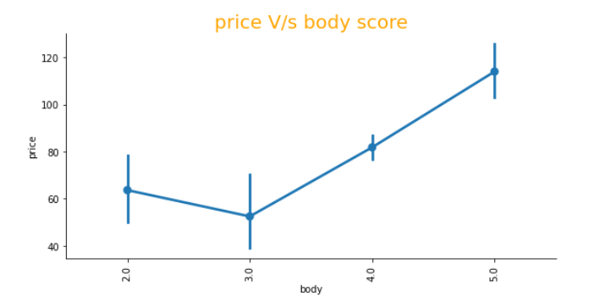
BI VARIATE ANALYSIS

Slide 15
prices of wines is low for wines which have grapes harvested about 20-30 years.
But as the data range values after 1990 would be interesting to see . There is clearly a downward trend , as time period is increasing price is decreasing. Old is Gold.
we can say that their is gradual increase in the price of wine with increase in ratings.(+ ve linear relation),we have also analyse the relation between number of years and ratings.
Older Wine is more valuable than recent grapped ones.
prices of wine is high, when the number of reviews are less . As price is positively linearly related with rating ,we have also checked the relation between ratings and number of reviews.
The more people review a wine, the less rating this wine get.
Their is linear positive relation between body score and price.
Prices of wines having high acidity values is low because most of high acidity score wines are made of grapes that are harvested in recent past, as we have already concluded Older wine has higher price.

Slide 16
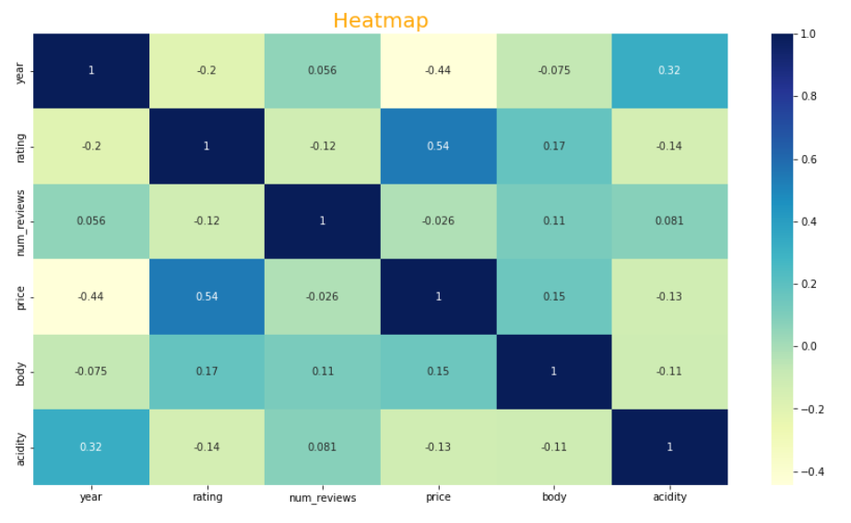
Heat-map
Their is high correlation between price and rating as already discussed.
We also have moderate correlation between year and acidity.
Their is also moderate relation between rating and year.
Their is high - ve correlation between price and year.

Slide 17
Fitting Different Model
Following classifiers are used for predicting whether employee seek mental treatment or not:
Linear Regression
Lasso Regression
Ridge Regression
Elastic net Regression
Decision Tree
Random Forest
Gradient Boosting
Xtreme Gradient Boosting

Slide 18
Model Approaches Used & Why
Random Forest Regressor
Model is over fitting for training set.
Hyper parameter Tuning.
Gradient Boosting
Model is over fitted.
GB Model using Grid Search CV
With Hyper parameter tuning this model’s r-2 Score is increased.
Linear Regression
R-2 Score Training and Testing is very low .
RMSE is very High.
Decision Tree Regressor
Model is Over fitting for Training set.
Lasso Regression
R-2 Score of Training and Testing is zero. Coeff of 1 variable is almost zero
XG Boost Regressor
Model is Over fitted.
XG Boost using Grid Search CV
With Hyper parameter tuning this model accuracy gives best r-2 Score.
Ridge Regression
R-2 Score Training and Testing is very low.
RMSE is very high
Elastic Net Regression
R-2 Score Training and Testing is very low.
RMSE is very High.

Slide 19
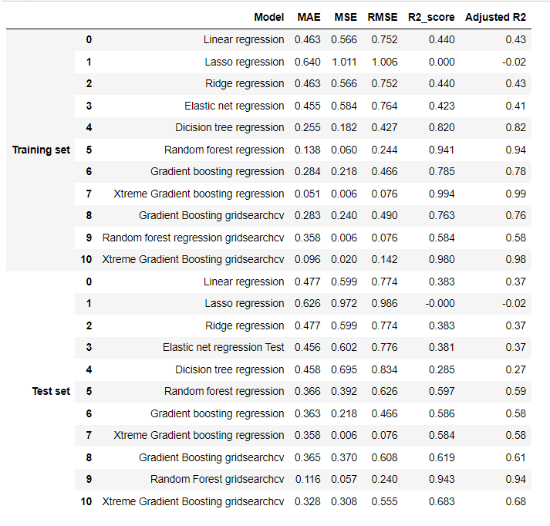
Performance Metrices
Overfitting is seen for random forest regression , gradient boosting , xtreme gradient boosting.
Xtreme Gradient Boosting gridsearch cv gives the highest R2 score of 98% for Train Set and Gradient Boosting gridsearch cv gives the highest R2 score of 68% for Test set , which is decent.
We can deploy this model.

Slide 20
Final Conclusions
The ensemble models have performed well compared to that of linear, Decision Tree.
The best performance is given by the Xtreme Gradient boosting model.
The top key features that drive the price of the wine are: rating , year , wine , acidity , region etc.
We can conclude from above that xtreme gradient boosting GridSearch CV is giving better results compared to that of normal gradient boosting.
The above data is also reinforced by the analysis done during bivariate analysis.

Slide 21


